Slide 1
DPM Final Project – Week 3
TEAM 11

Slide 2
Gantt Chart Update
Refer to Application

Slide 3
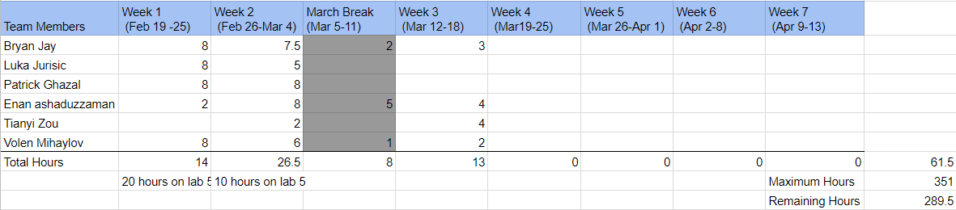
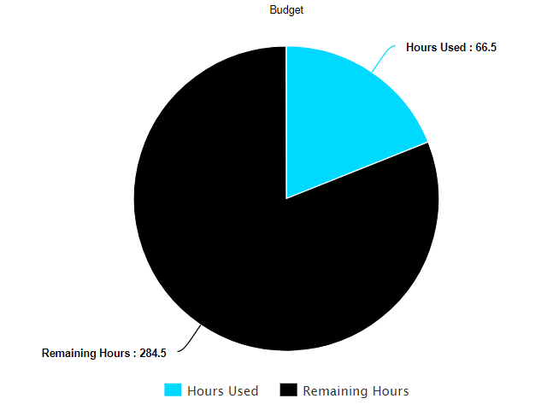
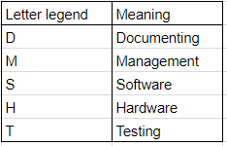
Budget Update

Slide 4
Design Prototype - Treads
Design 1
Loose tread since the wheels didn’t span the whole tread.
Had a lot of trouble in navigation which compiled to a massive error at the end.
Design 2
One wheel was lifted slightly, tightening the tread.
Treads easily travelled through the bumps from the bridge.
Accuracy in navigation was still present.

Slide 5
Design Prototype - Regular Wheels
Design 1
Designed consisted of two wheels for each motor (increase traction)
One marble on back end.
Design had a lot of trouble traversing the bridge due to the marble.
Navigation was not an issue by this design
Design 2
Same design as the first. Only difference was the robot had two marbles supporting back end.
Robot was barely able to traverse the bridge.
Conclusion was that the marble was not a viable option.
Design 3
Two wheels on both motors to increase traction.
Marble was replaced with a single wheel at the back end.
The robot plowed through the bridge with ease, similar to the treads.

Slide 6
Hardware Conclusion
It was concluded that the regular wheels would be used over the treads.
Regular wheels traversed the bridge similar to the treads, but completed the navigation better.
Since the final project depends heavily on navigation, it is important to utilize the hardwares that best implements an accurate navigation.
Next Week
Create the lazy wheel to replace the current stable wheel at the back end of the robot.
Complete and finalize the tests for the method of transportation.
Start applying the light sensors to the robot.

Slide 7
Testing Design Update
Test the performance of light sensor by measuring the distance from sensor to the detected object. Find the range where the sensor starts detection until it fails to detect.
Action: 1 cm is an optimized distance. We would place the light sensor 11 cm above the ground (i.e. 1 cm from the color block) to detect blocks.
Later in this week, we will test the accuracy of ultrasonic sensor by comparing the real distance from wall to the sensor and the measured distance.
Test how wide of the area that the ultrasonic sensor is able to detect in different distances

Slide 8
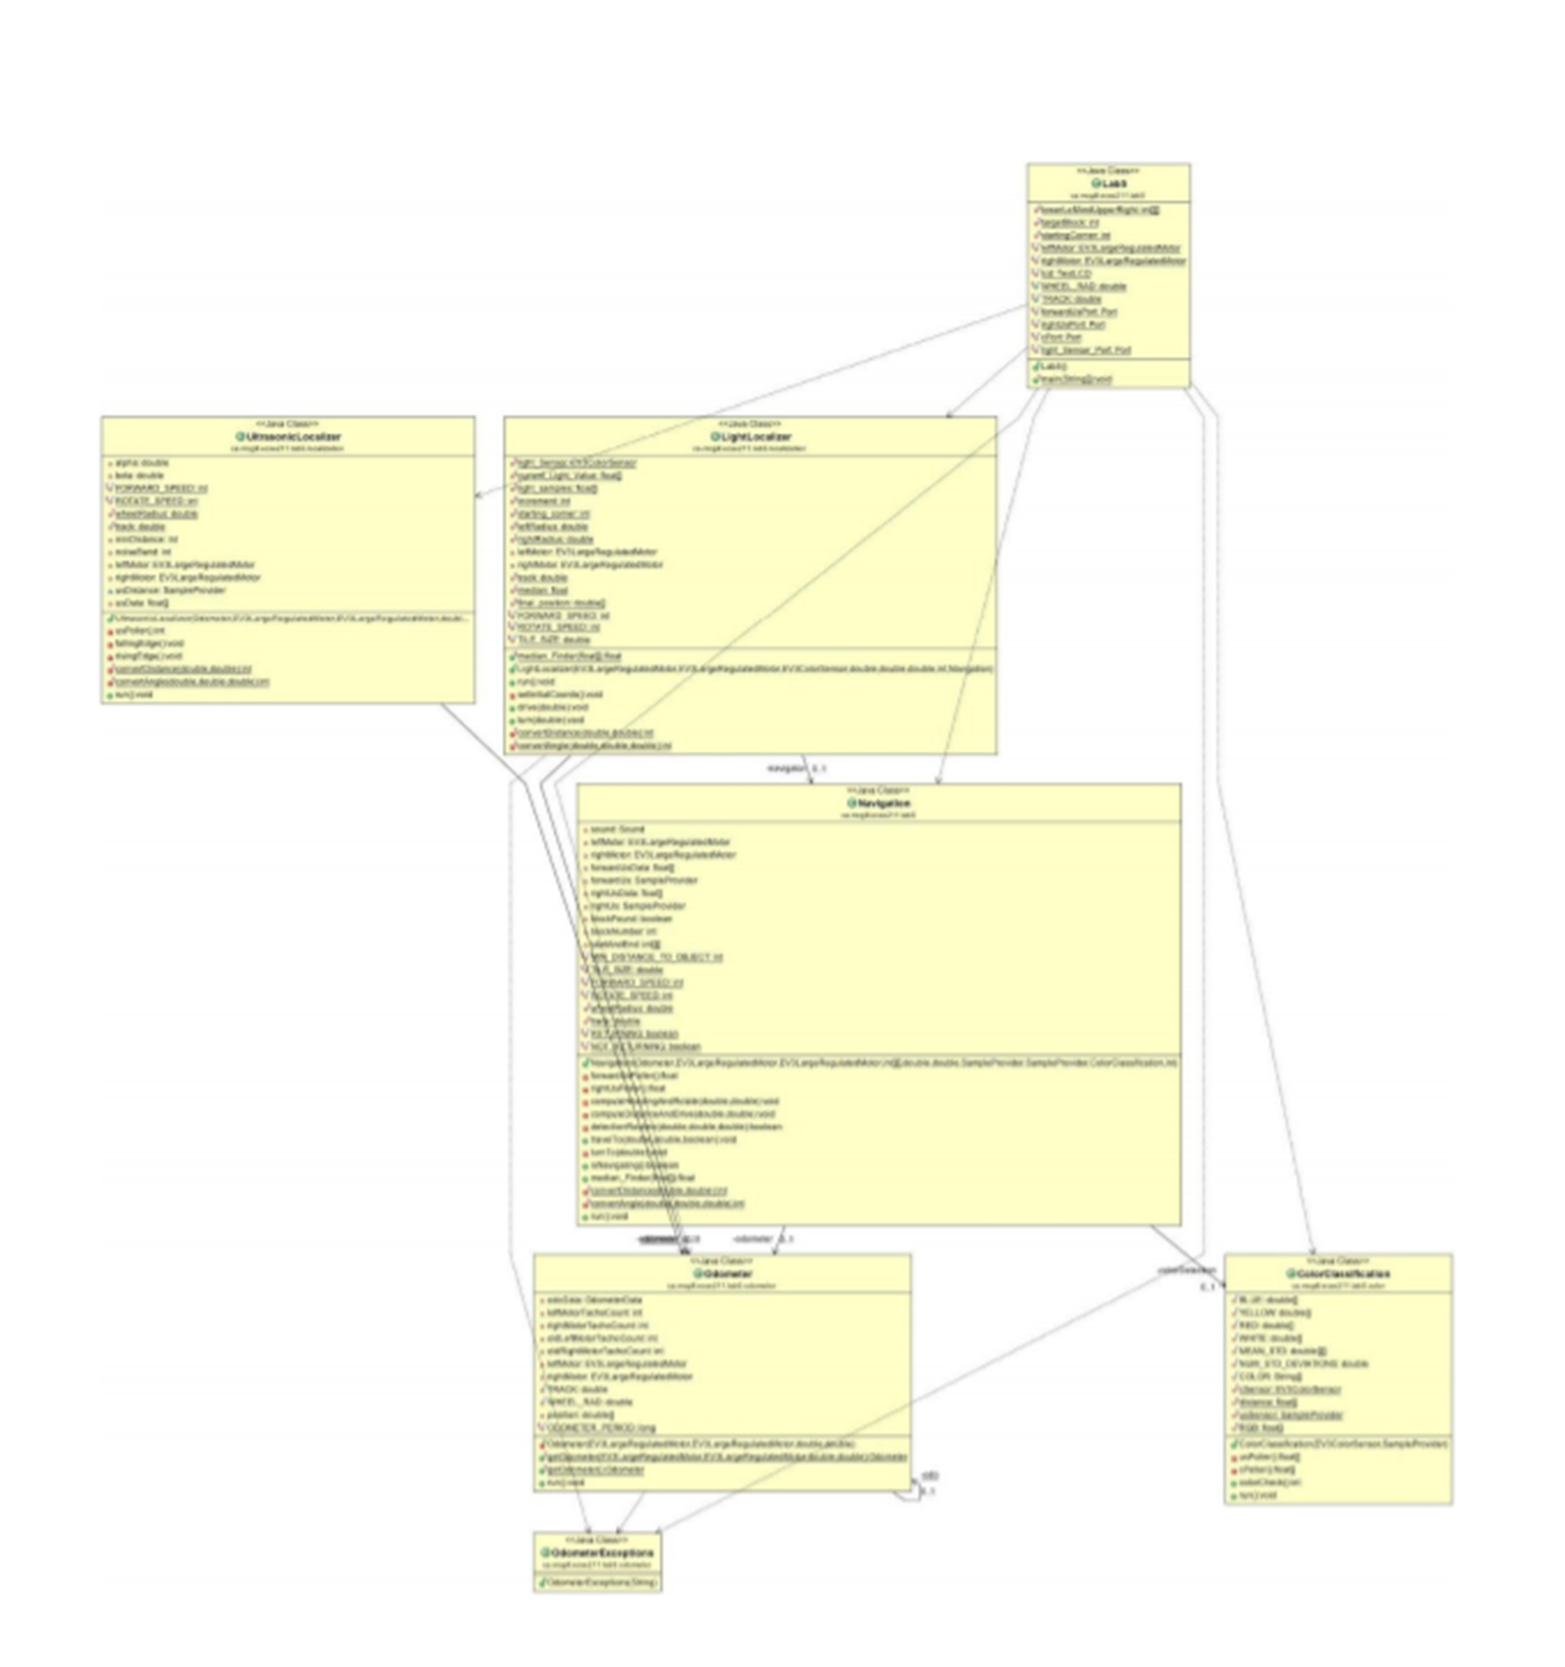
Software Class Hierarchy
Major Changes to be made:
Lab5.class -> Controller.class (contains the obstacle avoidance code and main function)
ColourCalibration.class: removal of multi-block system (only one flag)
Navigation.class: Change from radians to degree
Navigation.class: addition of simple movement classes
Display.class -> Removed (useless thread)
LightLocalizer : Code change to different localization system
Robot.class : New robot class to contain all variables to limit RAM usage due to public variables/duplicates
Old Class Hierarchy

Slide 9
API Documentation
JAVA Docs
To be further worked on after changes

Slide 10
Version Control
Snippet from README.md
“The version shall be written as such XX.XX.XX (ex: 04.02.13)”
“Every time a software milestone (obstacle breach) has been reached* the first number changes”
“Every time a new working implementation has been made the second number shall be changed” “For small changes that do not add further functionality, the last number shall be changed”

Slide 11
Status of Code
Talk about what is done with our code and what needs to be done

Slide 12
Next Steps
Complete the build of our hardware prototype
Test the odometry accuracy of our prototype
Develop our Localization algorithm, Robot class, Navigation
Update documentation

Slide 13
Any Questions?

